Slide 1
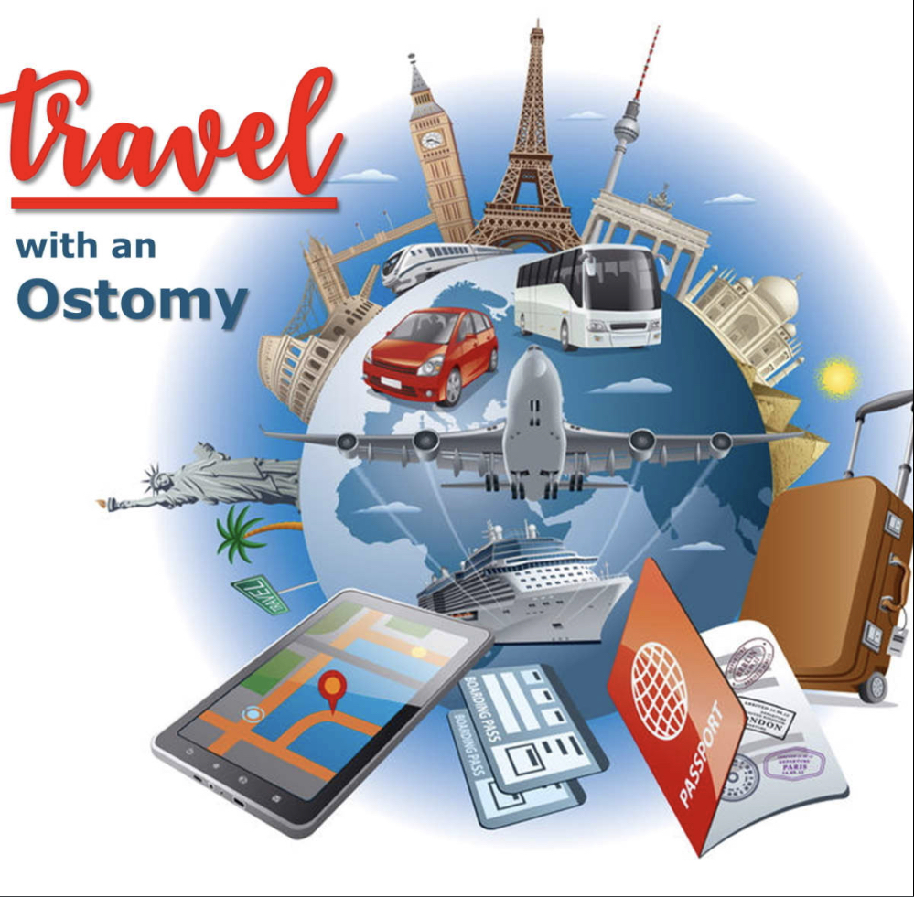
Julie st-georges

Slide 2
Summary
Kind of travel / Getaway’s
Support bubble / Communication
Travel list / and Certificate
important contacts / links
Brain dumps

Slide 3
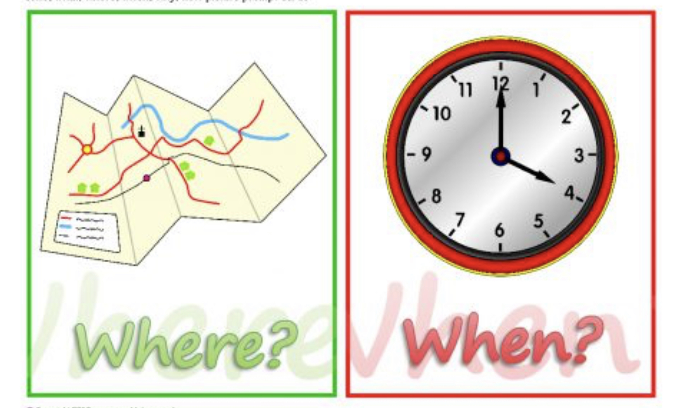
Where/ When / Duration
WHERE/ WHEN
WEATHER IN AREA
DURATION OF TRAVEL ( rule of thumb is pack supplies X 3 )

Slide 4
Kind of travels / Getaways
Short trip or local trip
Day outing
Far away trip
Events

Slide 5
Support bubble / Communication
Communications of your need to your support person is crucial
Concerns and anxiety of your travel
Have plan for yourself and your support person(s)

Slide 6
Travel Planning Tips
Plan number of days gone and bring extra supplies with you.
Bring as much supplies with you on plane and pre-cut to the right size before leaving a you are not guaranteed to keep your scissors.
Get a travel certificate for travel with medical supplies.
Write a LIST of what to bring, concern and question for your Doctor and what you need help with from your support circle.
Take the time needed to prepare yourself ( mentally, physically, emotionally).
Add up the number of Ostomy supplies and accessories you typically use per day not, multiply that number by the number of days you plan to be away, that should be your bare minimum to pack with you.
If travelling by air make sure to follow flying guidelines.

Slide 7
Terrific Travel Hints
1 Change your pouch within 24 hours before departure to assure proper complete adherence.
2 Take at least twice as many supplies as you think you may need. Pack these in your carryon case along with a change of clothing for emergencies. ( personally I would not let these get out of my hands ).
3 When traveling by air, car, train, pony express, burro, or camel, during a hike or bungee jumping, protect supplies from extreme heat and cold. New ostomates who ignore this caution may have flanges that won’t stick or plastic pouches that crack .
4 Air pressure in planes may affect the fullness of your pouch, so empty it before you board. Take
supplies in carryon and don’t dislodge your pouch by lifting a suitcase into the overhead bin. Sure, we know we are repeating not to check your supplies, because it’s that important.

Slide 8
Tips to help itch anxiety
Communication is critical
Be clear on the help you need
Yeah order is on the way

Slide 9
Important contacts/ links
https://meplus.convatec.com/articles/traveling-with-an-ostomy-what-to-pack/
https://badgut.org/information-centre/ostomies/travelling-with-an-ostomy/
https://www.ostomy.org/take-stress-air-travel-ostomy/
https://www.hollister.ca/en-CA/OstomyCare/OstomyLearningCenter/LivingWithAnOstomy/TravelPrep5ToDosIfYouHaveAStoma
https://www.coloplast.ca/ostomy/people-with-an-ostomy/living-with-an-ostomy/travelling-with-an-ostomy/
https://www.bladderandbowel.org/bowel/stoma/travelling-with-a-stoma

Slide 10
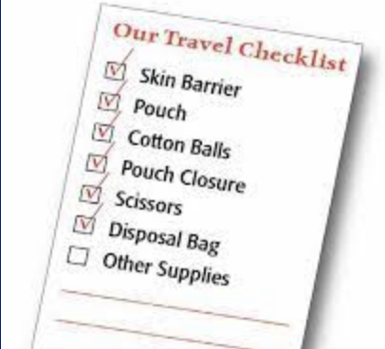
Ostomy scissor
Ostomy pouches
Kin barriers, wfer show me that, o most lied keyr flnges
Additional seals or paste
Ostomy paste
Varier film or wipe, spray
Adhesive remover wipe, spray
Ostomy pouch cleaner or deodorizer
Ostomy belt or wrap
Disposal bags

